Slide 1
矩阵函数的微分与积分
主讲人：赵维锐
单位：武汉理工大学

Slide 2

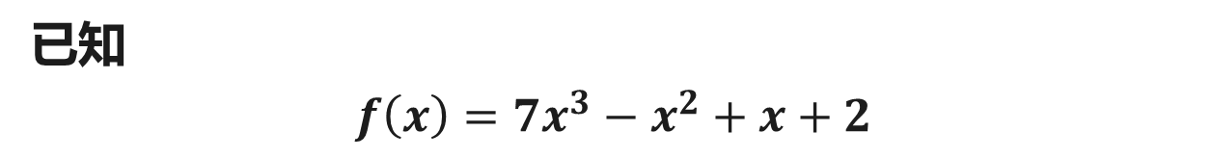
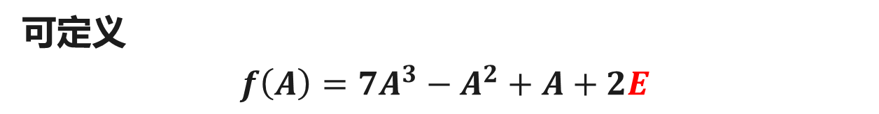
矩阵函数
已知
$$f\left(x\right)=7x^{3}−x^{2}+x+2$$
可定义
$$f\left(A\right)=7A^{3}−A^{2}+A+2E$$
注：$f(A)$以矩阵$A$为自变量，称之为矩阵$A$的函数，简称为矩阵函数

Slide 3
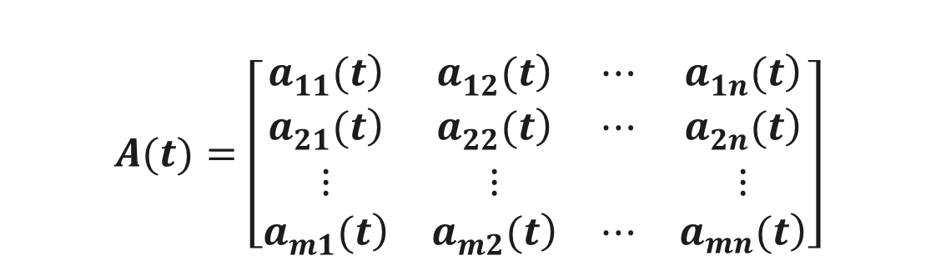


函数矩阵的概念
定义
称变量$t$的矩阵
$$A(t)=\left[\begin{matrix}\left.a_{11}^{}(t\right) & \left.a_{12}^{}(t\right) & ⋯ & \left.a_{1n}^{}(t\right) \\ \left.a_{21}^{}(t\right) & \left.a_{22}^{}(t\right) & ⋯ & \left.a_{2n}^{}(t\right) \\ ⋮ & ⋮ & & ⋮ \\ \left.a_{m1}^{}(t\right) & \left.a_{m2}^{}(t\right) & ⋯ & \left.a_{mn}^{}(t\right)\end{matrix}\right]$$
为函数矩阵.
例如
$$A(t)=\left[\begin{matrix}sint & t^{2} & t+1 \\ 1 & t−1 & lnt\end{matrix}\right]$$

Slide 4


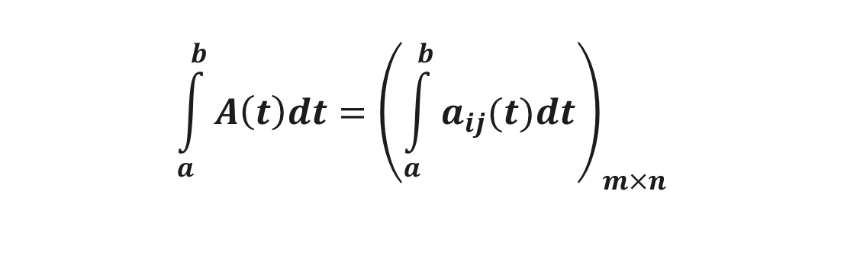
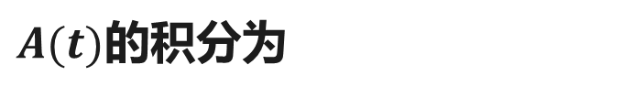
函数矩阵的微分
定义
设函数矩阵$A\left(t\right)={\left(a_{ij}\left(t\right)\right)}_{m×n}$的位置元均可微（可积）, 则$A(t)$的微分为
$$\frac{d}{dt}A(t)={\left(\frac{d}{dt}a_{ij}\left(t\right)\right)}_{m×n}$$
$A(t)$的积分为
$$\int_{a}^{b}{A\left(t\right)dt}={\left(\int_{a}^{b}{a_{ij}(t)dt}\right)}_{m×n}$$

Slide 5
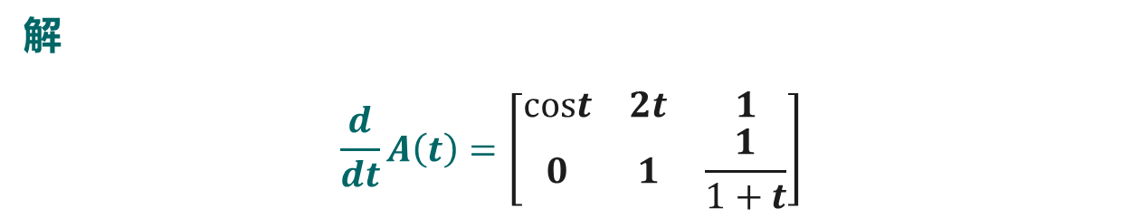
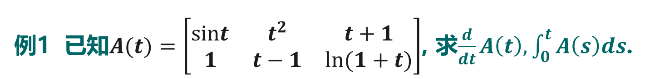
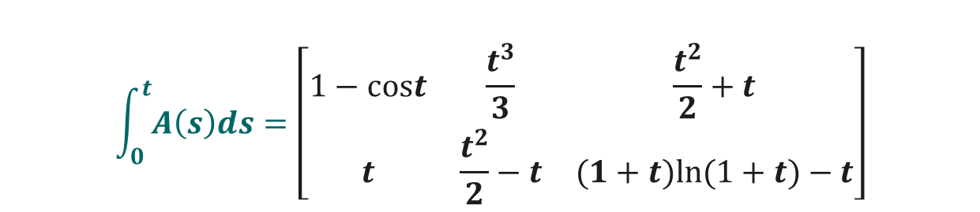
函数矩阵的概念
例1 已知$A(t)=\left[\begin{matrix}sint & t^{2} & t+1 \\ 1 & t−1 & ln(1+t)\end{matrix}\right]$, 求$\frac{d}{dt}A\left(t\right),\int_{0}^{t}{A\left(s\right)ds}$.
解
$$\frac{d}{dt}A\left(t\right)=\left[\begin{matrix}cost & 2t & 1 \\ 0 & 1 & \frac{1}{1+t}\end{matrix}\right]$$
$$\int_{0}^{t}{A\left(s\right)ds}=\left[\begin{matrix}1−cost & \frac{t^{3}}{3} & \frac{t^{2}}{2}+t \\ t & \frac{t^{2}}{2}−t & (1+t)ln(1+t)−t\end{matrix}\right]$$

Slide 6



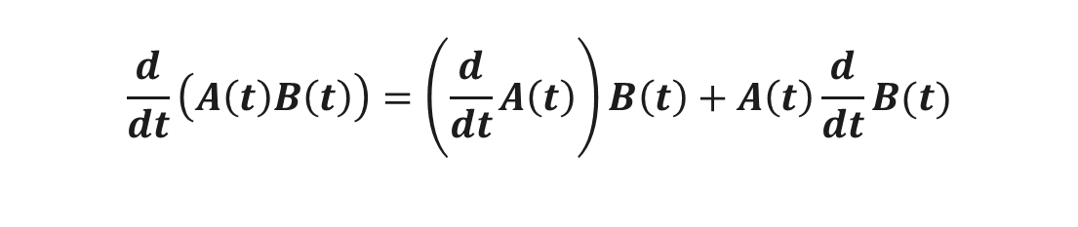
函数矩阵微分的性质
性质
设$A\left(t\right),B(t)$为同阶可微矩阵, 则
$$\frac{d}{dt}\left(A\left(t\right)+B\left(t\right)\right)=\frac{d}{dt}A\left(t\right)+\frac{d}{dt}B(t)$$
设$A\left(t\right),B(t)$分别为$m×n,n×l$可微矩阵, 则
$$\frac{d}{dt}\left(A\left(t\right)B\left(t\right)\right)=\left(\frac{d}{dt}A\left(t\right)\right)B\left(t\right)+A\left(t\right)\frac{d}{dt}B(t)$$
设$A\left(t\right),A^{−1}\left(t\right)$为可微矩阵, 则
$$\frac{d}{dt}\left(A^{−1}\left(t\right)\right)=−A^{−1}\left(t\right)\left(\frac{d}{dt}A\left(t\right)\right)A^{−1}(t)$$

Slide 7
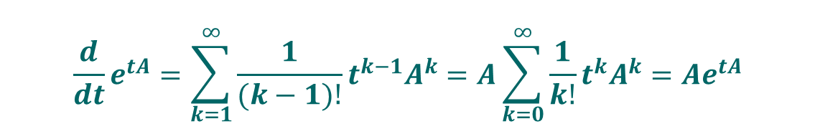


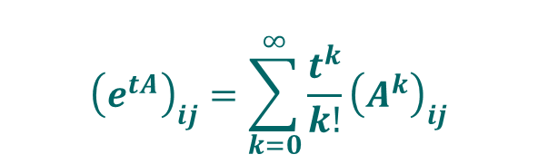
函数矩阵微分的性质
例2 设n阶矩阵$A,$ 证明
$$\frac{d}{dt}e^{tA}=Ae^{tA}=e^{tA}A$$
$${\left(e^{tA}\right)}_{ij}=\sum_{k=0}^{∞}{\frac{t^{k}}{k!}{\left(A^{k}\right)}_{ij}}$$
证明 注意到$e^{tA}$的第$i$行第$j$列元素为
于是$e^{tA}$的各位置元逐项微分
$${\frac{d}{dt}\left(e^{tA}\right)}_{ij}=\sum_{k=1}^{∞}{\frac{1}{(k−1)!}{t^{k−1}\left(A^{k}\right)}_{ij}}$$
从而
$$\frac{d}{dt}e^{tA}=\sum_{k=1}^{∞}{\frac{1}{(k−1)!}t^{k−1}A^{k}=A}\sum_{k=0}^{∞}{\frac{1}{k!}t^{k}A^{k}=Ae^{tA}}$$

Slide 8
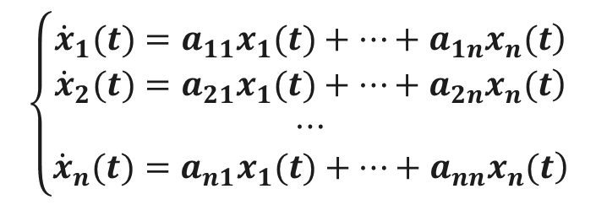



函数矩阵的应用
已知一阶常系数线性齐次微分方程组
$$\left\{\begin{matrix}\left.{\dot{x}}_{1}(t)=a_{11}x_{1}(t)+⋯+a_{1n}x_{n}(t\right) \\ \left.{\dot{x}}_{2}(t)=a_{21}x_{1}(t)+⋯+a_{2n}x_{n}(t\right) \\ ⋯ \\ \left.{\dot{x}}_{n}(t)=a_{n1}x_{1}(t)+⋯+a_{nn}x_{n}(t\right)\end{matrix}\right.$$
初始条件为
$$x_{1}\left(t_{0}\right)=c_{1},⋯,x_{n}\left(t_{0}\right)=c_{n}$$
令$A={\left(a_{ij}\right)}_{n×n},x\left(t\right)={\left(x_{1}\left(t\right),⋯,x_{n}\left(t\right)\right)}^{T}$
则微分方程组可以写为
$$\left\{\begin{matrix}\left.\dot{x}(t)=Ax(t\right) \\ x(t_{0})=c\end{matrix}\right.$$

Slide 9
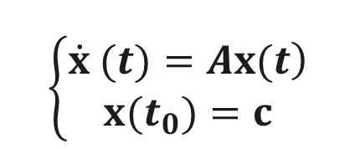
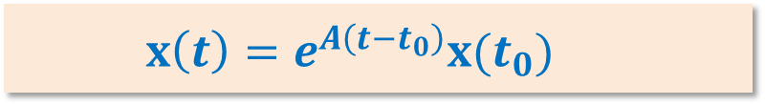
函数矩阵的应用
定理
一阶常系数线性齐次微分方程组
$$\left\{\begin{matrix}\left.\dot{x} (t)=Ax(t\right) \\ x(t_{0})=c\end{matrix}\right.$$
的解为
$$x\left(t\right)=e^{A\left(t−t_{0}\right)}x(t_{0})$$
证明：略.

Slide 10
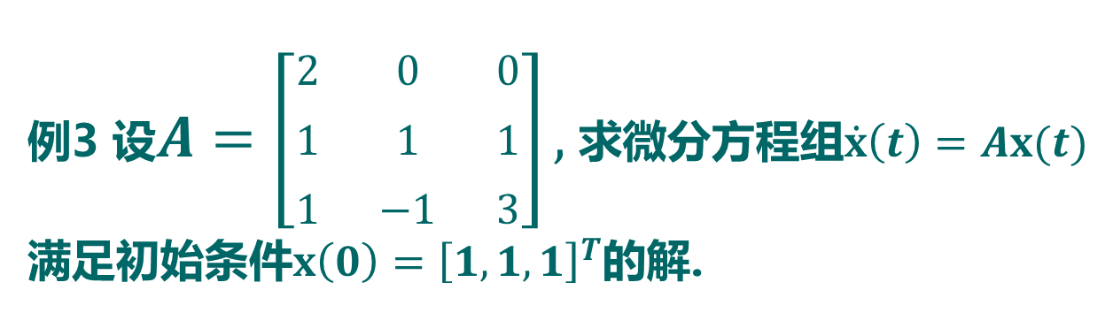

函数矩阵的应用
例3 设$A=\left[\begin{matrix}2 & 0 & 0 \\ 1 & 1 & 1 \\ 1 & −1 & 3\end{matrix}\right],$ 求微分方程组$\dot{x}\left(t\right)=Ax(t)$满足初始条件$x\left(0\right)={\left[1,1,1\right]}^{T}$的解.
解：首先，求矩阵函数$e^{At}$
$$e^{At}=e^{2t}\left[\begin{matrix}1 & 0 & 0 \\ t & 1−t & t \\ t & −t & 1+t\end{matrix}\right]$$
其次，微分方程组的解为
$$x\left(t\right)=e^{At}x\left(0\right)={\left[e^{2t},\left(1+t\right)e^{2t},\left(1+t\right)e^{2t}\right]}^{T}$$

Slide 11
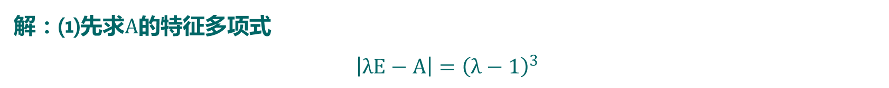
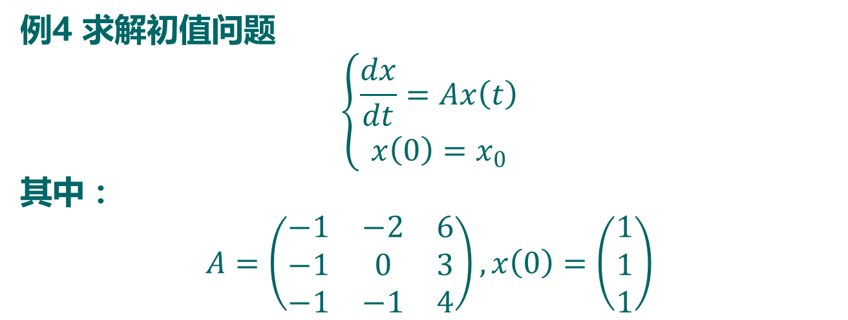
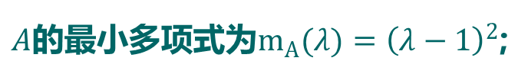
例4 求解初值问题
$$\left\{\begin{aligned}\frac{dx}{dt}=Ax\left(t\right) \\ x\left(0\right)=x_{0}\end{aligned}\right.$$
其中：
$$A=\left(\begin{matrix}−1 & −2 & 6 \\ −1 & 0 & 3 \\ −1 & −1 & 4\end{matrix}\right),x\left(0\right)=\left(\begin{matrix}1 \\ 1 \\ 1\end{matrix}\right)$$
解：⑴先求$A$的特征多项式
$$\left|λE−A\right|={\left(λ−1\right)}^{3}$$
$A$的最小多项式为$m_{A}(λ)={\left(λ−1\right)}^{2}$;

Slide 12
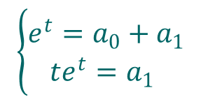
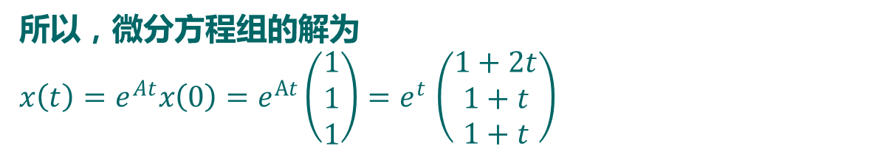
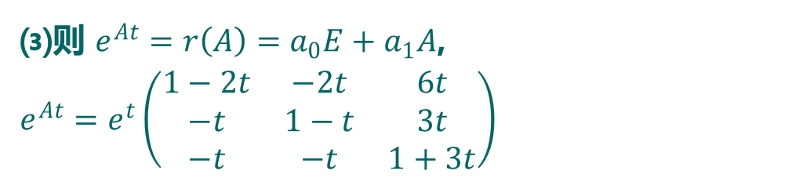
⑵设 $e^{λt}=q\left(λ\right)m_{A}\left(λ\right)+r\left(λ\right)$, $r\left(λ\right)=a_{0}+a_{1}λ$, 则
$$\left\{\begin{aligned}e^{t}=a_{0}+a_{1} \\ te^{t}=a_{1} \end{aligned}\right.$$
解之得$a_{0}=e^{t}−te^{t}$， $a_{1}=te^{t}$
⑶则 $e^{At}=r\left(A\right)=a_{0}E+a_{1}A$,
$$e^{At}=e^{t}\left(\begin{matrix}1−2t & −2t & 6t \\ −t & 1−t & 3t \\ −t & −t & 1+3t\end{matrix}\right)$$
所以，微分方程组的解为
$$x\left(t\right)=e^{At}x\left(0\right)=e^{At}\left(\begin{matrix}1 \\ 1 \\ 1\end{matrix}\right){=e}^{t}\left(\begin{matrix}1+2t \\ 1+t \\ 1+t\end{matrix}\right)$$

Slide 13
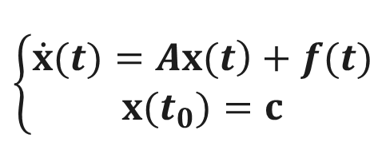
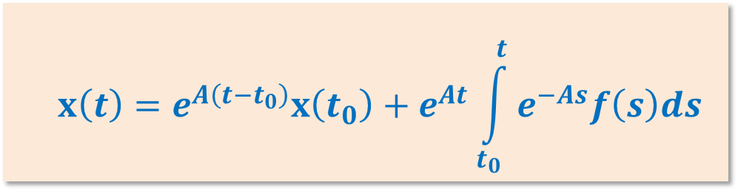
函数矩阵的应用
定理
一阶常系数线性非齐次微分方程组
$$\left\{\begin{matrix}\left.\dot{x}(t)=Ax(t\right)+f(t) \\ x(t_{0})=c\end{matrix}\right.$$
的解为
$$x\left(t\right)=e^{A\left(t−t_{0}\right)}x\left(t_{0}\right)+e^{At}\int_{t_{0}}^{t}{e^{−As}f\left(s\right)ds}$$

Slide 14
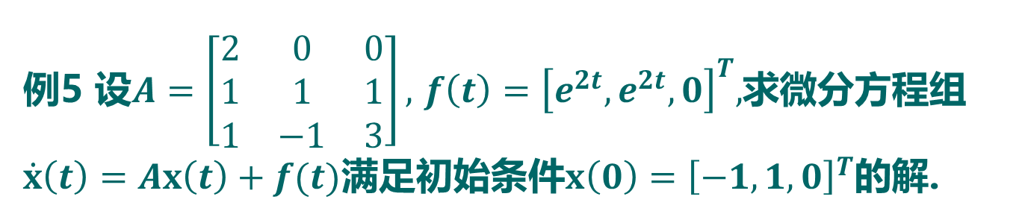
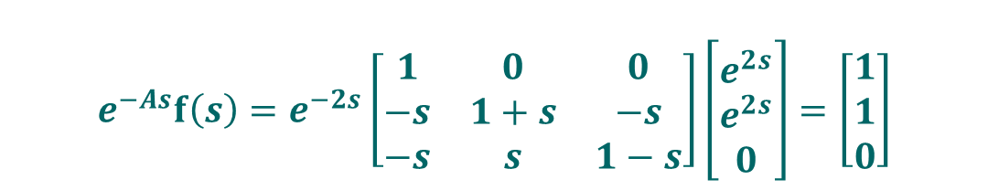
函数矩阵的应用
例5 设$A=\left[\begin{matrix}2 & 0 & 0 \\ 1 & 1 & 1 \\ 1 & −1 & 3\end{matrix}\right],$ $f\left(t\right)={\left[e^{2t},e^{2t},0\right]}^{T},$求微分方程组$\dot{x}\left(t\right)=Ax\left(t\right)+f(t)$满足初始条件$x\left(0\right)={\left[−1,1,0\right]}^{T}$的解.
解：首先，求矩阵函数$e^{At}$
$$e^{At}=e^{2t}\left[\begin{matrix}1 & 0 & 0 \\ t & 1−t & t \\ t & −t & 1+t\end{matrix}\right]$$
其次，计算
$$e^{−As}f\left(s\right)=e^{−2s}\left[\begin{matrix}1 & 0 & 0 \\ −s & 1+s & −s \\ −s & s & 1−s\end{matrix}\right]\left[\begin{matrix}e^{2s} \\ e^{2s} \\ 0\end{matrix}\right]=\left[\begin{matrix}1 \\ 1 \\ 0\end{matrix}\right]$$

Slide 15




函数矩阵的应用
例5 设$A=\left[\begin{matrix}2 & 0 & 0 \\ 1 & 1 & 1 \\ 1 & −1 & 3\end{matrix}\right],$ $f\left(t\right)={\left[e^{2t},e^{2t},0\right]}^{T},$求微分方程组$\dot{x}\left(t\right)=Ax\left(t\right)+f(t)$满足初始条件$x\left(0\right)={\left[−1,1,0\right]}^{T}$的解.
由此
$$\int_{0}^{t}{e^{−As}f\left(s\right)ds}=\left[\begin{matrix}t \\ t \\ 0\end{matrix}\right]$$
故微分方程组的解为
$$x\left(t\right)=e^{At}x\left(0\right)+e^{At}\int_{0}^{t}{e^{−As}f\left(s\right)ds}$$
$$=e^{At}\left[\begin{matrix}−1 \\ 1 \\ 0\end{matrix}\right]+e^{At}\left[\begin{matrix}t \\ t \\ 0\end{matrix}\right]=\left[\begin{matrix}\left(t−1\right)e^{2t} \\ \left(1−t\right)e^{2t} \\ −2te^{2t}\end{matrix}\right]$$

Slide 16
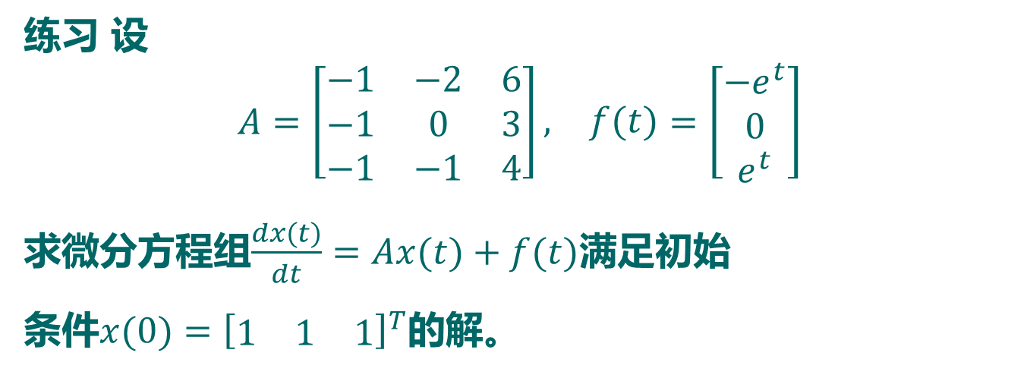
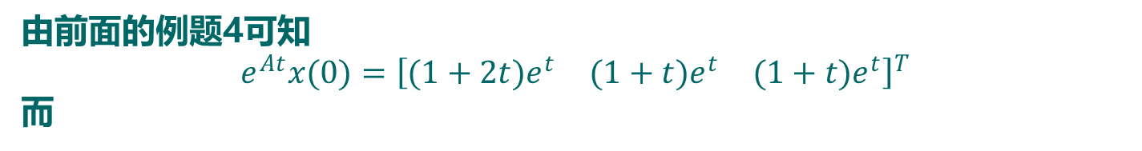
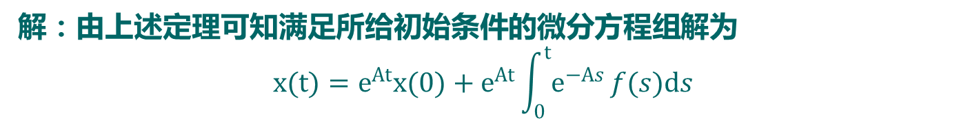
练习 设
$$A=\left[\begin{matrix}−1 & −2 & 6 \\ −1 & 0 & 3 \\ −1 & −1 & 4\end{matrix}\right]\begin{matrix}, & f(t)\end{matrix}=\left[\begin{matrix}−e^{t} \\ 0 \\ e^{t}\end{matrix}\right]$$
求微分方程组$\frac{dx(t)}{dt}=Ax(t)+f(t)$满足初始
条件$x(0)={\left[\begin{matrix}1 & 1 & 1\end{matrix}\right]}^{T}$的解。
解：由上述定理可知满足所给初始条件的微分方程组解为
$$x(t)=e^{At}x(0)+e^{At}\int_{0}^{t}{e^{−As}}f(s)ds$$
由前面的例题4可知
$$e^{At}x(0)={\left[\begin{matrix}(1+2t)e^{t} & (1+t)e^{t} & (1+t)e^{t}\end{matrix}\right]}^{T}$$
而

Slide 17

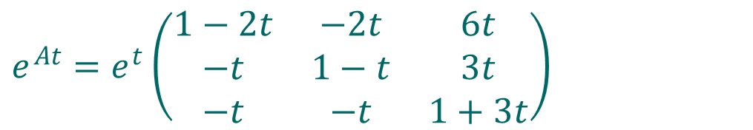
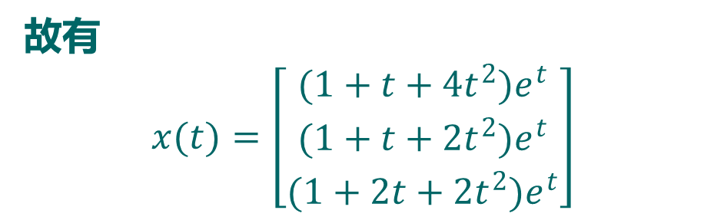
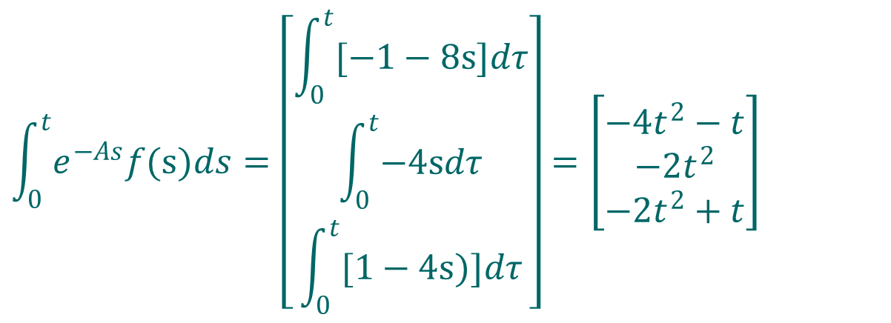
$$e^{At}=e^{t}\left(\begin{matrix}1−2t & −2t & 6t \\ −t & 1−t & 3t \\ −t & −t & 1+3t\end{matrix}\right)$$
所以有$e^{−As}f(s)=\left[\begin{matrix}−1−8s \\ −4s \\ 1−4s\end{matrix}\right]$
$$\int_{0}^{t}{e^{−As}f(s)ds}=\left[\begin{matrix}\int_{0}^{t}{[−1−8s]dτ} \\ \int_{0}^{t}{−4sdτ} \\ \int_{0}^{t}{[1−4s)]dτ}\end{matrix}\right]=\left[\begin{matrix}−4t^{2}−t \\ −2t^{2} \\ −2t^{2}+t\end{matrix}\right]$$
故有
$$x(t)=\left[\begin{matrix}(1+t+4t^{2})e^{t} \\ (1+t+2t^{2})e^{t} \\ (1+2t+2t^{2})e^{t}\end{matrix}\right]$$

